Slide 1
Natural Language Processing
Unveiling the Power of Words for Hotel Review Insights

Slide 2
TABLE OF CONTENTS
01
02
03
04
05
06
Introduction
Sentiment Analysis
Extracting Comment Topic Themes
Subset for Training and Splitting Reviews
Model Results and Evaluation
Model Training and Tuning

Slide 3
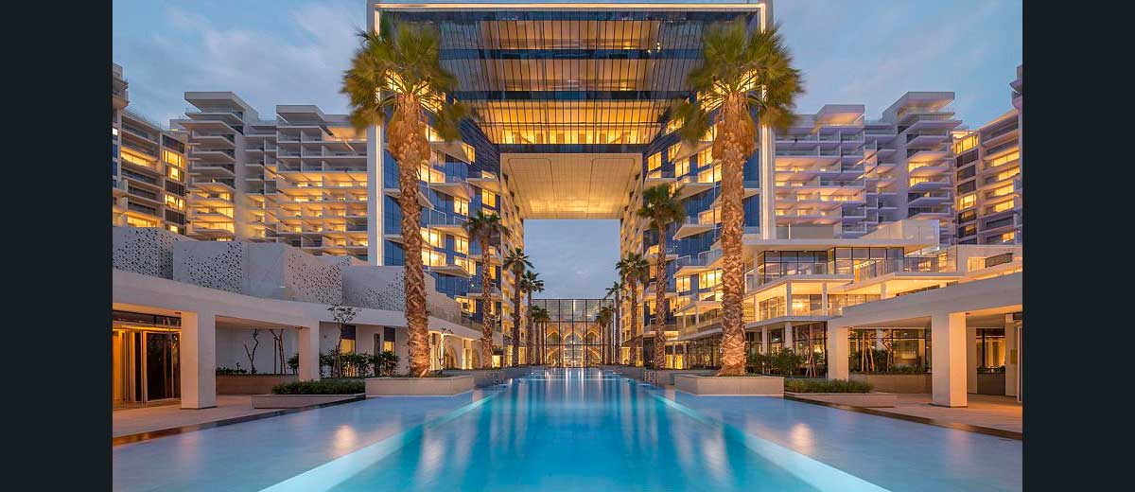
INTRODUCTION
INTRODUCTION
The project aims to extract insights from a large volume of hotel reviews, focusing on sentiment analysis and theme identification.
With our advanced NLP techniques, we decode the sentiment behind each comment, enabling businesses to gauge customer satisfaction levels accurately.
The project aims to extract insights from a large volume of hotel reviews, focusing on sentiment analysis and theme identification.
By leveraging NLP, the project seeks to enable businesses to showcase review classifications on their website, enhancing user experience and facilitating informed decision-making

Slide 4

Project Overview
The project aims to extract insights from a large volume of hotel reviews, focusing on sentiment analysis and theme identification.
With our advanced NLP techniques, we decode the sentiment behind each comment, enabling businesses to gauge customer satisfaction levels accurately.
The project aims to extract insights from a large volume of hotel reviews, focusing on sentiment analysis and theme identification.
By leveraging NLP, the project seeks to enable businesses to showcase review classifications on their website, enhancing user experience and facilitating informed decision-making

Slide 5

Dataset
Source: https://archive.ics.uci.edu/dataset/205/opinrank+review+dataset
Analysis and models for hotel comments will be built using the OpinRank Review Dataset
Hotels located in New York
The total number of reviews: 50,656
The shortest review: 10 characters
The longest review: 793 characters
The average review: 981 characters
Tools:
Pandas
Numpy
Matplotlib
Seaborn
WordCloud
Sklearn
NLTK
Textblob
Pickle
Gensim
Torch
BERT

Slide 6
Data Science Process Flow
Comment Sentiment Classification
Iterative Analysis for Curating Training Data
Model results evaluation
Analyzing Comments with Diverse Sentiments through Visualizations
Model training and tuning

Slide 7

SENTIMENT ANALYSIS
Sentiment analysis
Sentiment Analysis Method:
TextBlob library with PatternAnalyzer for efficiency in handling formal text
Positive if score > 0, Negative if score < 0
Observations and Challenges:
Positive sentiment dominant.
Challenges with informal language and sarcasm.
Abbreviations like 'fab' affecting accuracy.
Accuracy Evaluation:
Manual review of 100 random comments per sentiment class.
Neutral sentiment class: 60% accuracy.
Positive sentiment class: 80% accuracy.
Negative sentiment class: 100% accuracy.

Slide 8
Sentiment analysis
Sentiment Analysis Method:
TextBlob library with PatternAnalyzer for efficiency in handling formal text
Positive if score > 0, Negative if score < 0
Observations and Challenges:
Positive sentiment dominant.
Challenges with informal language and sarcasm
Abbreviations like 'fab' affecting accuracy
Accuracy Evaluation:
Manual review of 100 random comments per sentiment class
Neutral sentiment class: 60% accuracy
Positive sentiment class: 80% accuracy
Negative sentiment class: 100% accuracy

Slide 9



Sentiment analysis
Observations and Challenges:
Positive sentiment dominant.
Challenges with informal language and sarcasm
Abbreviations like 'fab' affecting accuracy
‘A very comfortable Hotel in mid Manhattan. Ideal location with most attractions within easy walking distance. Probably the most helpful and friendly doormen outside of Dubai.Rooms very comfortable indeed', "There are many good things about this Hotel but unfortunately our stay had a couple of bad experiences.”’
Sentiment Analysis Method:
TextBlob library with PatternAnalyzer for efficiency in handling formal text
Positive if score > 0, Negative if score < 0
Accuracy Evaluation:
Manual review of 100 random comments per sentiment class
Neutral sentiment class: 60% accuracy
Positive sentiment class: 80% accuracy
Negative sentiment class: 100% accuracy
'I got jewelry stolen from the room!!!!!!!Bad customer service', 'After an attempted break-in of our room, management totally dropped the ball, failing to call the police and follow up with us once we returned home. I would not trust them again.', 'Cannot be beaten for comfort, customer service and location.’
‘What a BAD experience in a 4-star hotel. They have to be stripped of at least 1 star. I always stay at 4- or 5-star hotel, since 4-star hotel can feel like 5-stars or 3-stars. This was supposed to be a romantic Valentine getaway. I was coming by car. There was nobody at the front or sides door to help me with my car or luggage.’

Slide 10
‘A very comfortable Hotel in mid Manhattan. Ideal location with most attractions within easy walking distance. Probably the most helpful and friendly doormen outside of Dubai.Rooms very comfortable indeed', "There are many good things about this Hotel but unfortunately our stay had a couple of bad experiences.”’
'Avoid! Noisy air conditioner-small room-dark lobby-rude staff-crap swim', 'After a attempted break-in of our room, management totally dropped the ball, failing to call the police and follow up with us once we returned home. I would not trust them again.', 'Cannot be beaten for comfort, customer service and location.’
‘What a BAD experience in a 4-star hotel. They have to be stripped of at least 1 star. I always stay at 4- or 5-star hotel, since 4-star hotel can feel like 5-stars or 3-stars. This was supposed to be a romantic Valentine getaway. I was coming by car. There was nobody at the front or sides door to help me with my car or luggage.’

Slide 11
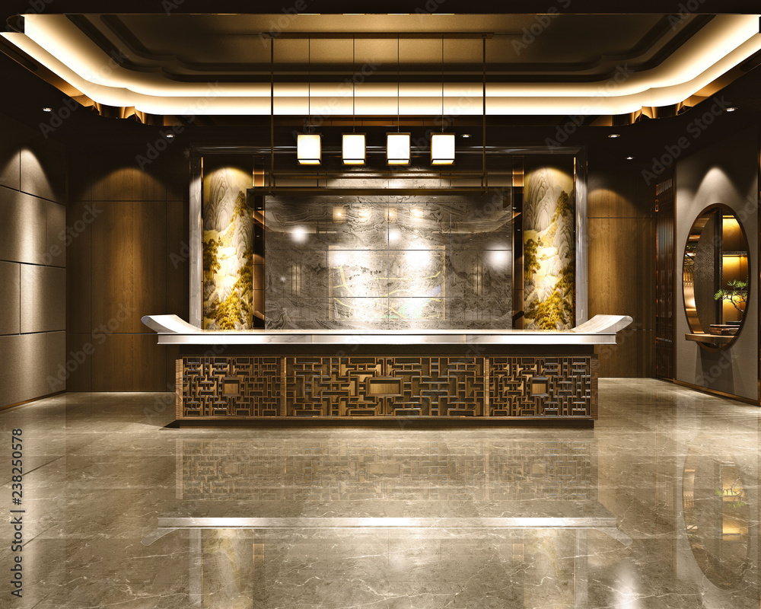
EXTRACTING COMMENT TOPIC THEMES

Slide 12
Exploring Positive and Negative Reviews
Objective: Analyze and Identify Significant Words Associated with Sentiments
Word Clouds: Visual Representation of Word Frequency
Size Corresponds to Frequency within the Corpus
Preprocessing Steps:
Stop Word Removal: Eliminating Common Words (e.g., "to," "at," "a")
Punctuation Removal: Enhancing Data Cleanliness
Lemmatization: Refining Words for Better Analysis
Benefits:
Gain Insights into Positive and Negative Sentiments
Identify Common Themes within Comments

Slide 13
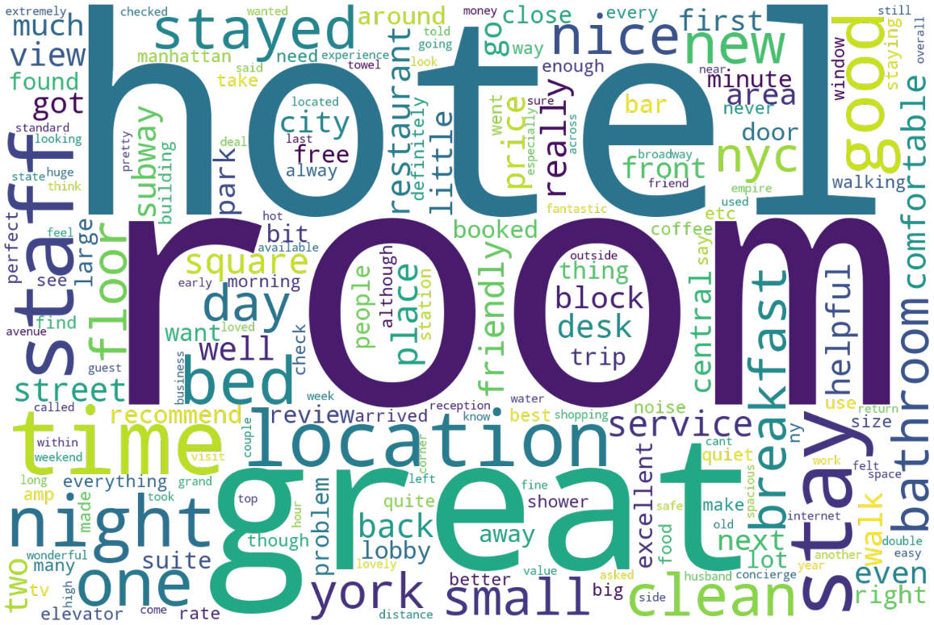
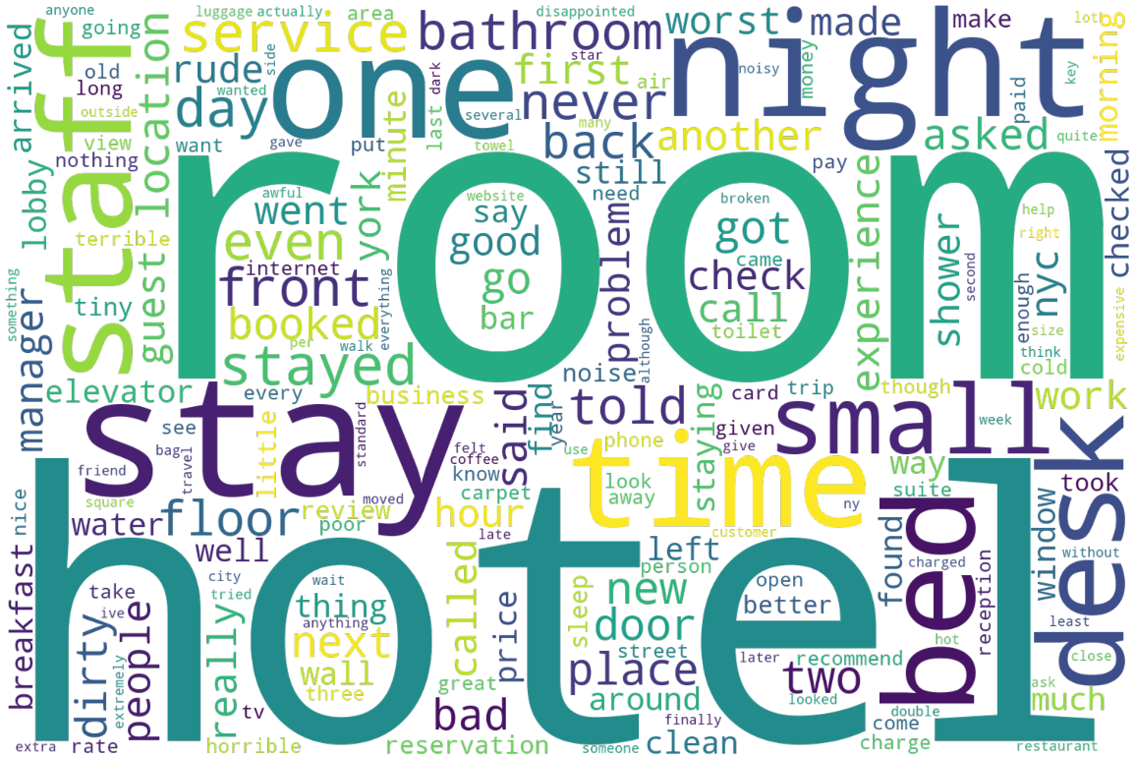
Word cloud for positive comments
Word cloud for negative comments

Slide 14
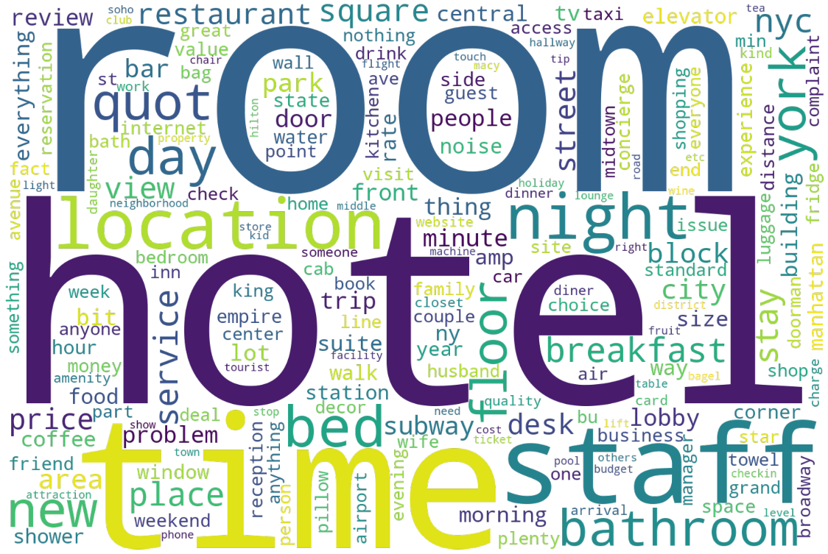
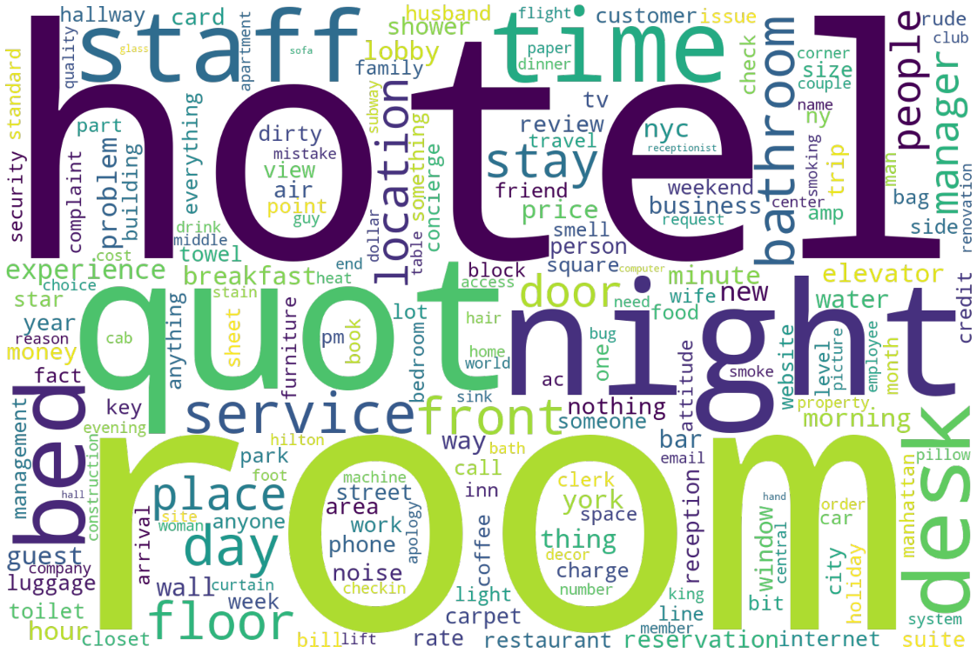
Word cloud for positive comments
Word cloud for negative comments
Word cloud for positive comments
(nouns)
Word cloud for negative comments
(nouns)

Slide 15
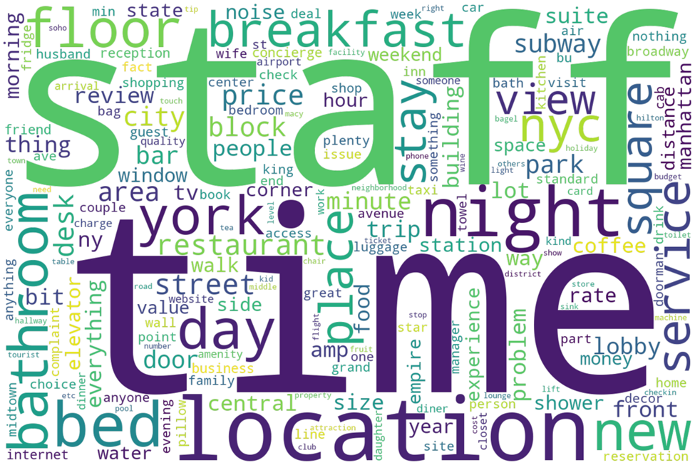
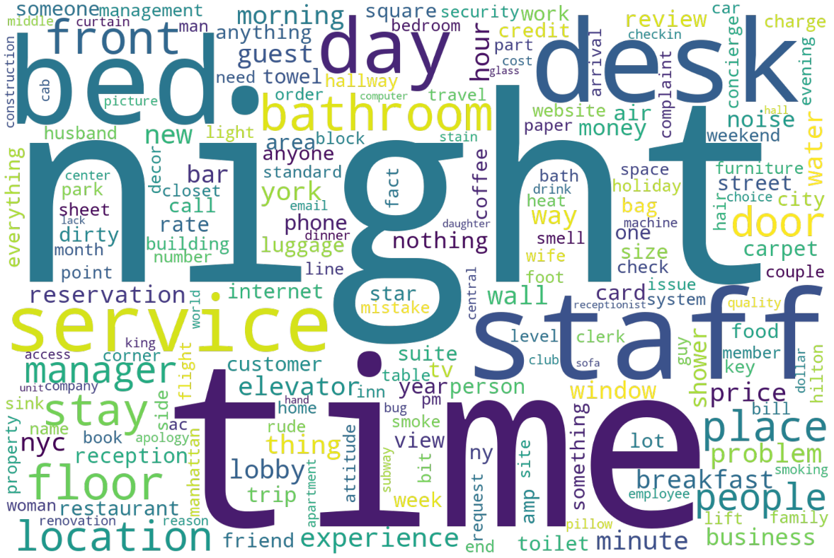
Word cloud for positive comments
(nouns)
Word cloud for negative comments
(nouns)
To improve the analysis of sentiments related to the room and hotel, we will apply additional cleaning functions to filter out non-nouns and generate new word clouds.
We will also exclude the words 'room' and 'hotel' to explore other themes associated with the positive and negative sentiment classes. This will allow for a more focused and comparative analysis of the sentiments expressed.
Word cloud for positive comments
(nouns)
Word cloud for negative comments
(nouns)

Slide 16
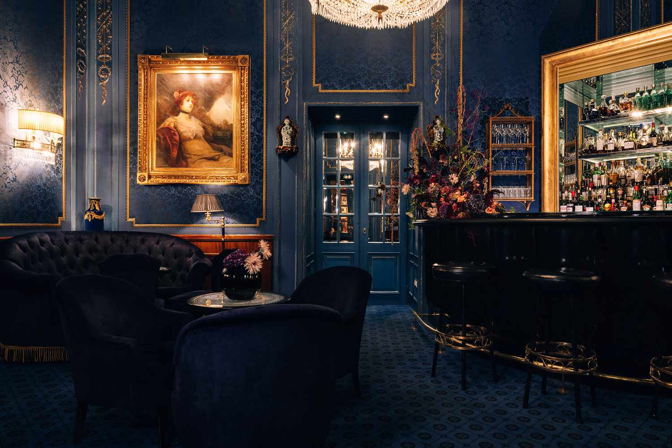
SUBSET FOR TRAINING AND SPLITTING REVIEWS

Slide 17
Taking A Subset For Training
Randomly select 80% of the available data, which corresponds to 37,992 comments, for the training phase. The remaining 20% of the data will be kept for testing purposes after the model is finalized.
While it is technically possible to utilize a zero-shot transformers-based model, the inference time associated with this approach can be substantial. Alternatively, one can opt to manually label data and train a classification model. However, this process can be time-consuming. Fortunately, there are methods available that can assist in creating a model without the need for manual labeling of each individual sample.

Slide 18
Splitting Reviews Into Phrases/Sentences
Hand-Curated Word List:
Approach: Curate a set of words representing a topic, generate word clouds for documents containing these words (excluding them), identify co-occurring words to expand the initial set, repeat for each topic.
Advantages: Quick gathering of training data, helps in classification problem initiation.
Disadvantages: Potential bias due to hand curation, need for bias mitigation by removing search words from appended documents if initial results are unsatisfactory.
Potential Improvement: Can serve as a baseline model for iterative improvement with more generalizable training data.
Clustering Algorithms Approach:
Approach: Employ clustering algorithms like LDA or K-means, inspect resulting clusters, manually verify relevance, and add documents to training dataset if accuracy is satisfactory.
Advantages: Allows for unsupervised grouping of documents, facilitates iterative refinement.
Disadvantages: Requires manual verification, potential high inference time.
Additional Technique: Utilize zero-shot classification for initial data labeling, followed by manual verification for result accuracy.

Slide 19
Method 1: Hand-Curated Word List
We initiate by hand-crafting a set of representative words for each topic of interest. For instance, we select "location" for the topic of location, "room," "bed," "bathroom," and "bedroom" for the room-related topic, and "service" and "staff" for the service and staff topic. Subsequently, we locate all documents containing these predetermined words.
Following this, we generate word clouds to visualize the most prominent noun words within these documents. Notably, we exclude frequently occurring terms such as "hotel" from the initial hand-curated set to focus on identifying additional relevant terms.

Slide 20
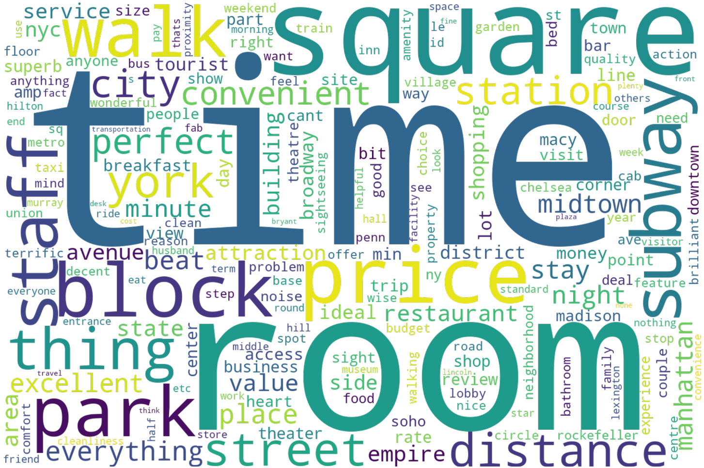
Location-word cloud
Service and Staff-word cloud

Slide 21
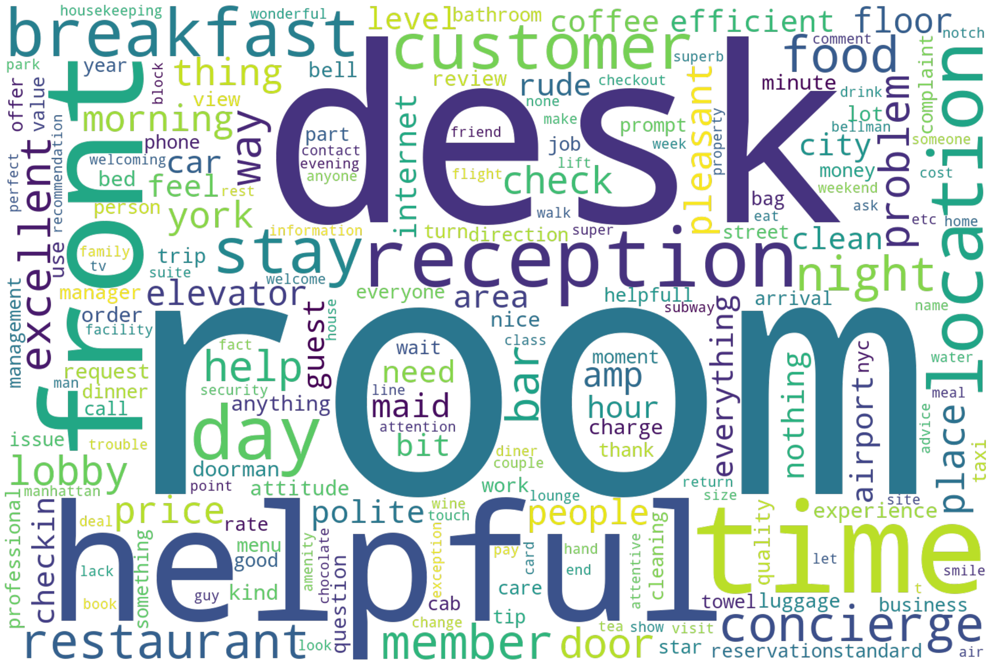
Location-word cloud
Room-word cloud

Slide 22
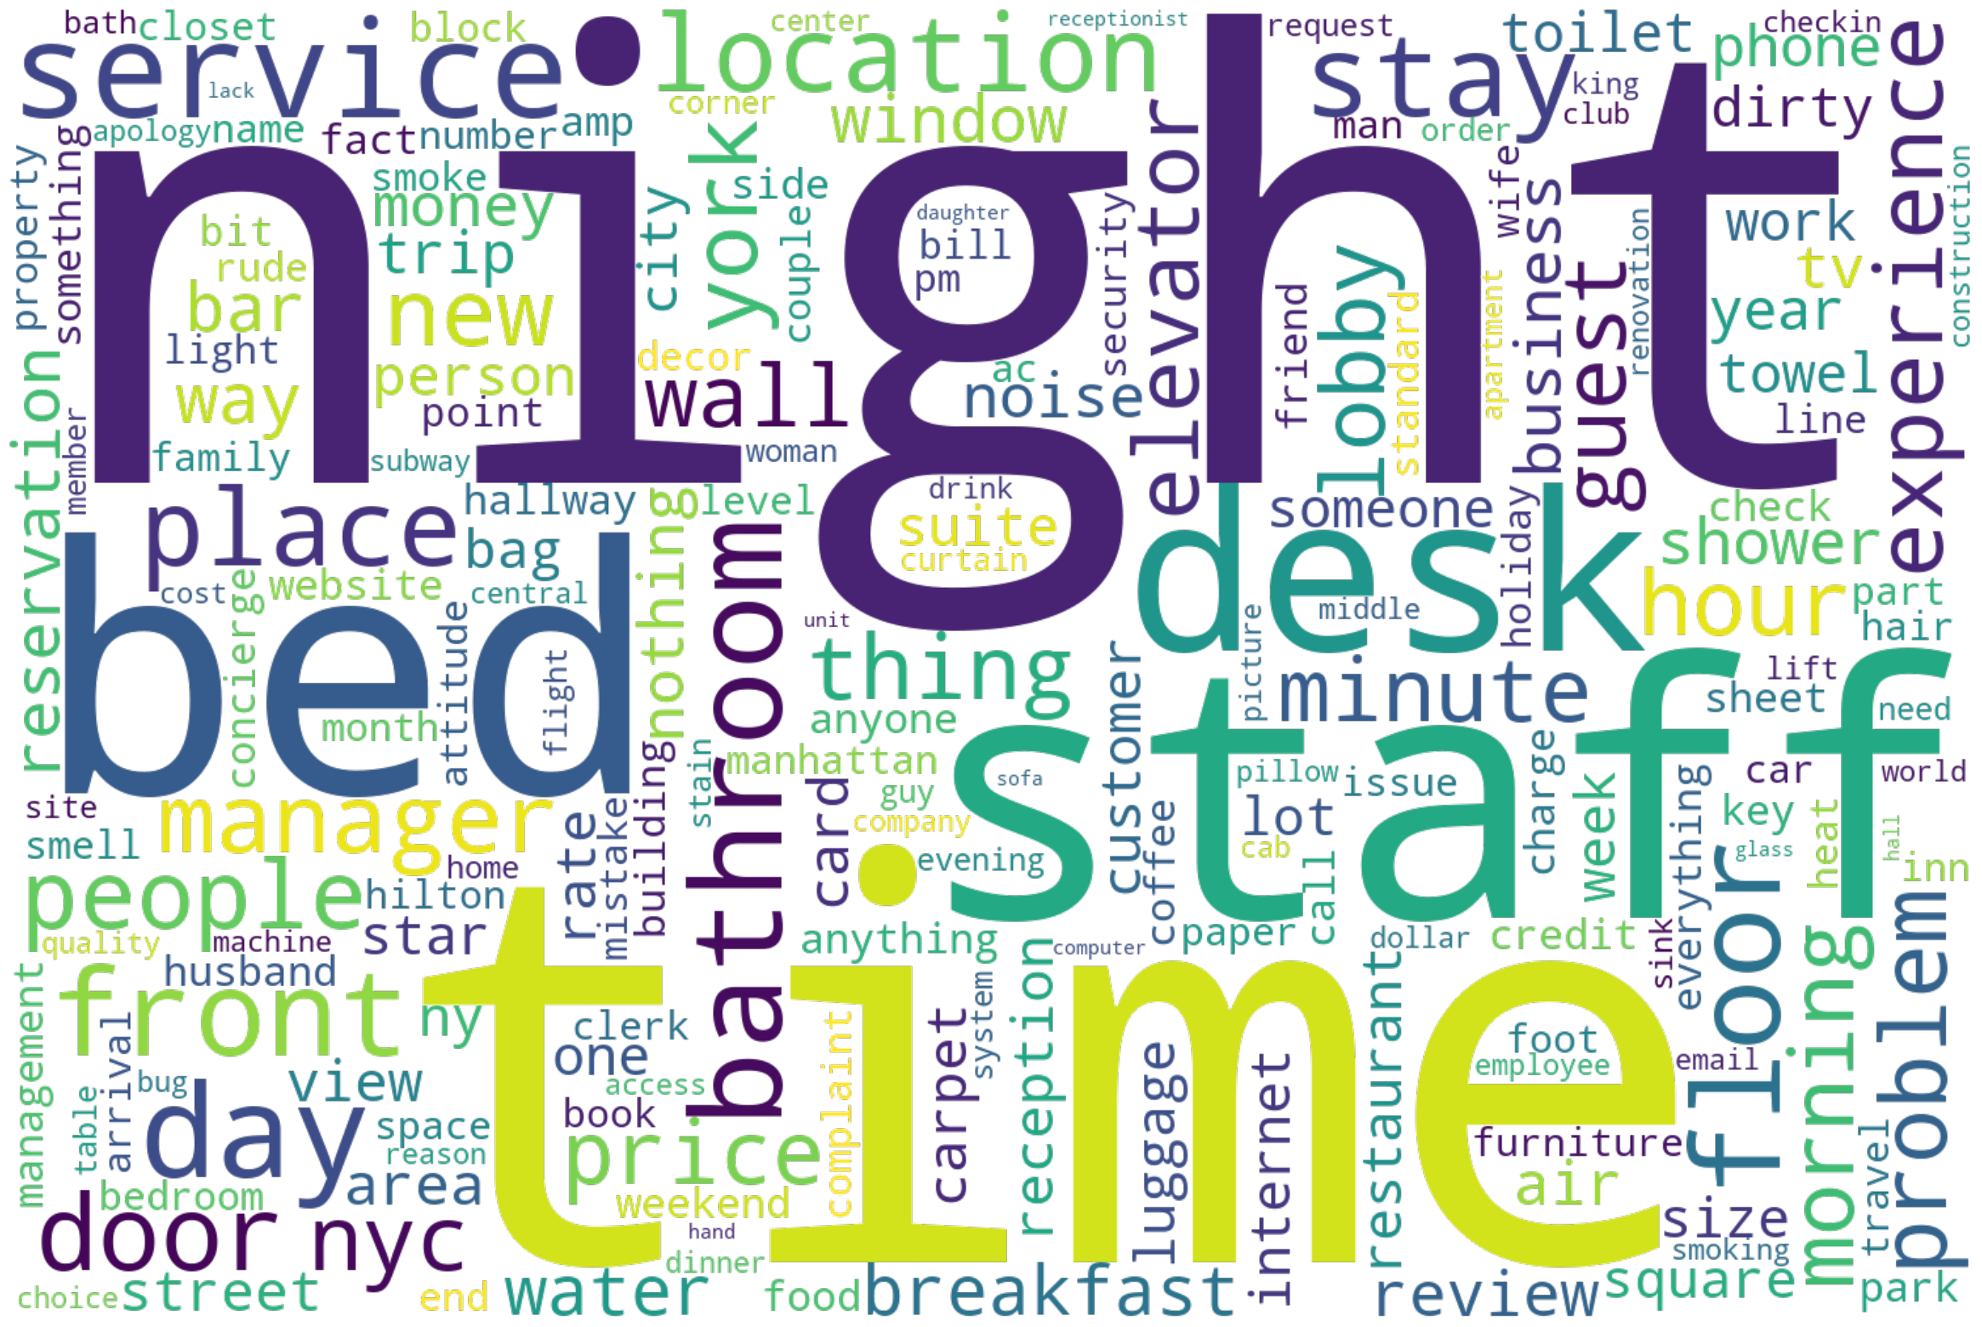
Room-word cloud
Staff and service-word cloud

Slide 23
Method 2: LDA-based Training Data Curation
LDA can be used in addition to or as an alternative to other data curation methods.
Hotel review data can be passed through the LDA algorithm with multiple runs using different numbers of clusters.
LDA clustering helps identify topics or themes within the reviews, such as cleanliness, service, location, amenities, and more.
Analyzing the clusters generated by LDA provides insights into customer sentiments and preferences.

Slide 24
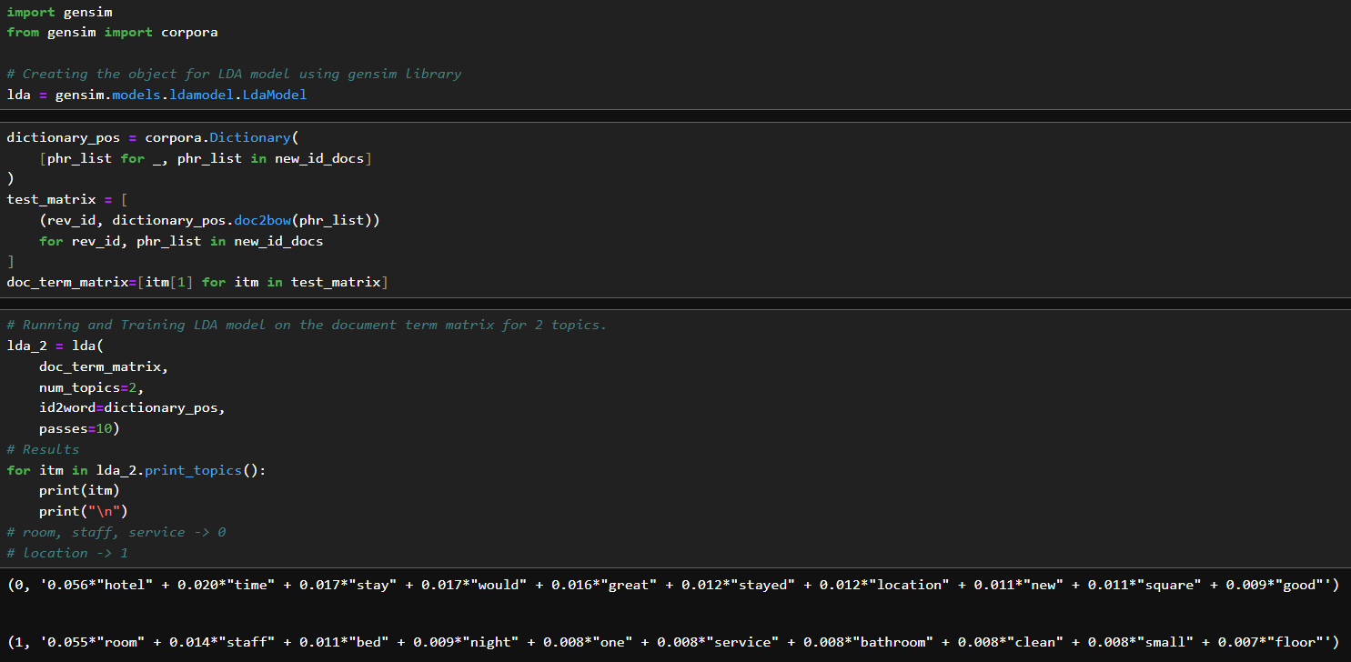
Two Topics
Cluster 0 exhibits associations with the topics of "room" and "service & staff“
Cluster 1 encompasses aspects pertinent to the topic of "location".

Slide 25
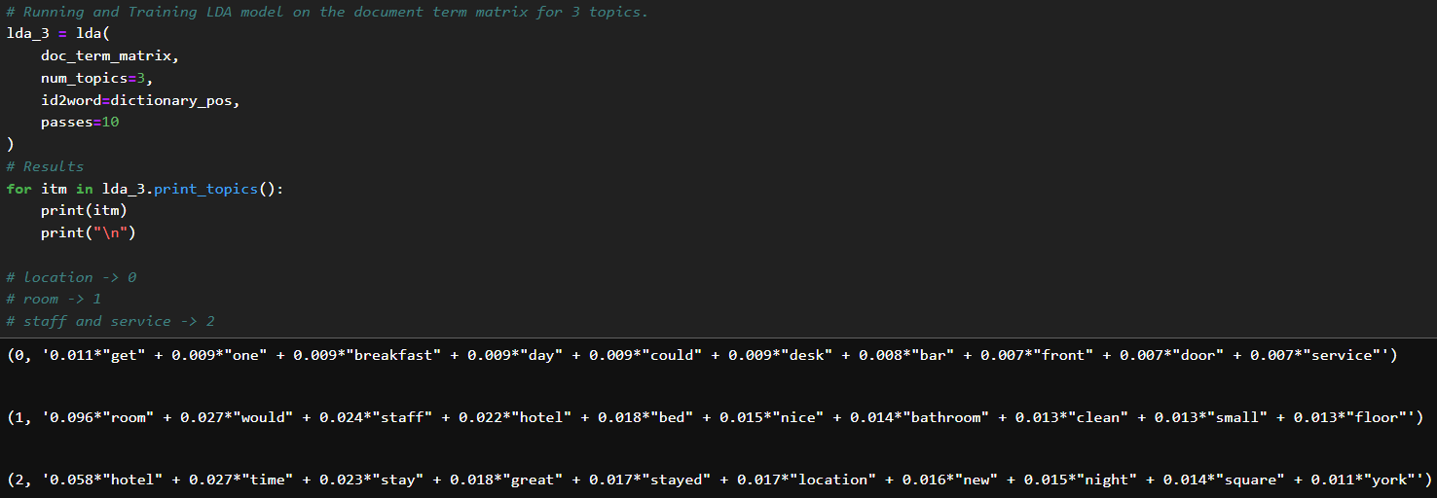
Two Topics
Three Topics
Cluster 0 shows few with the topics of “location“.
Cluster 1 shows strong relation to the topic of “room".
Cluster 2 strongly related to the topic “service & staff”.
Cluster 0 exhibits associations with the topics of "room" and "service & staff“
Cluster 1 encompasses aspects pertinent to the topic of "location".

Slide 26
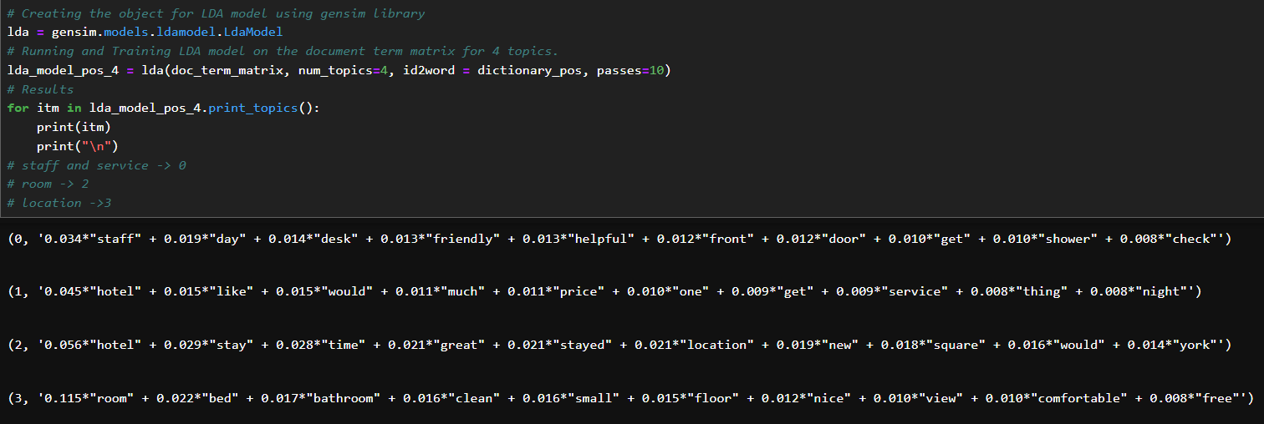
Three Topics
Four Topics
Cluster 0 relates strongly to the topics of “service & staff“.
Cluster 1 looks related between “location”, “room”, and “service & staff”.
Cluster 2 looks strongly related to the topic “room”.
Cluster 3 has aspects related to “location”.
Cluster 0 shows few with the topics of “location“.
Cluster 1 encompasses aspects pertinent to the topic of “room".
Cluster 2 strongly related to the topic “service & staff”.

Slide 27
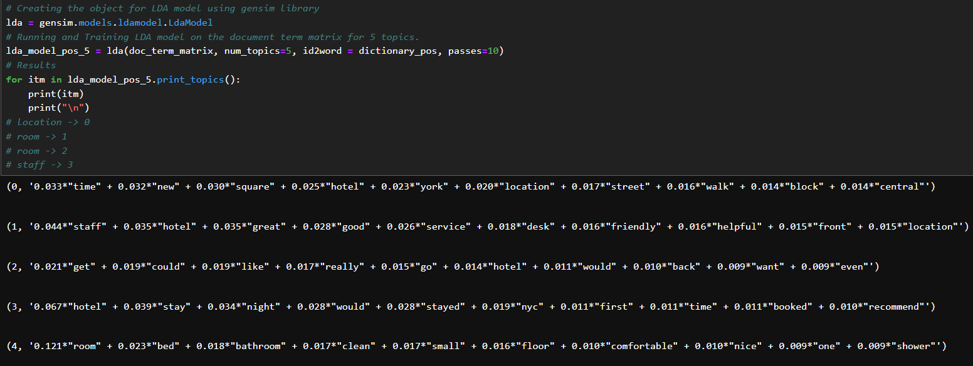
Four Topics
Five Topics
Cluster 0 demonstrates a strong correlation with the topic of "location", while Cluster 1 displays a strong association with the topic of "room". Additionally, Clusters 2 and 4 contain elements that pertain to the topic of "room", whereas Cluster 3 exhibits some indications of "service & staff".

Slide 28
Upon examining the resultant clusters, we observe that some are highly pertinent to our topics. Notably, Cluster 0 of the LDA model strongly aligns with the theme of "location".
To assess the quality of the data within this cluster, we conduct a random sampling of 100 documents assigned to Cluster 0. Through manual labeling, we determine that 72% of these documents are indeed relevant to the class "location".
To refine the document list further, we propose a method to identify and remove irrelevant documents using text similarity techniques.
By implementing this approach, we anticipate achieving a higher level of accuracy. Consequently, this process will yield refined training data tailored for the "location" class. Similar methodologies can be applied to enhance the data quality for the remaining classes.

Slide 29

MODEL TRAINING AND TUNING

Slide 30
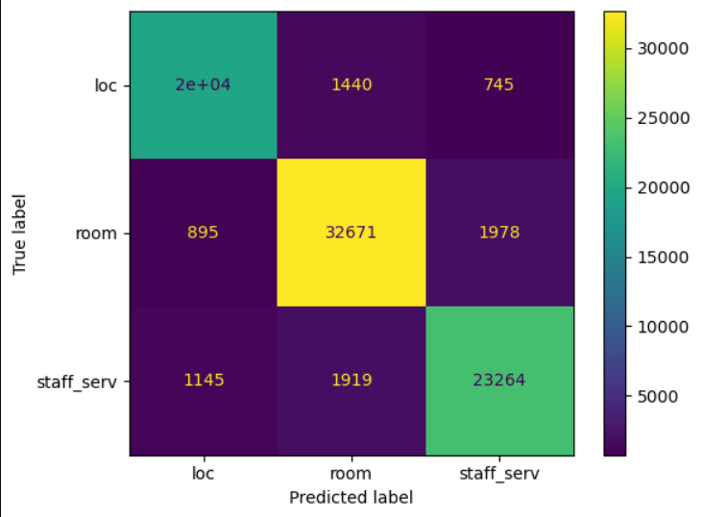
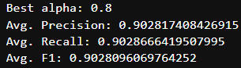
Multinomial Naïve Bayes Model

Slide 31
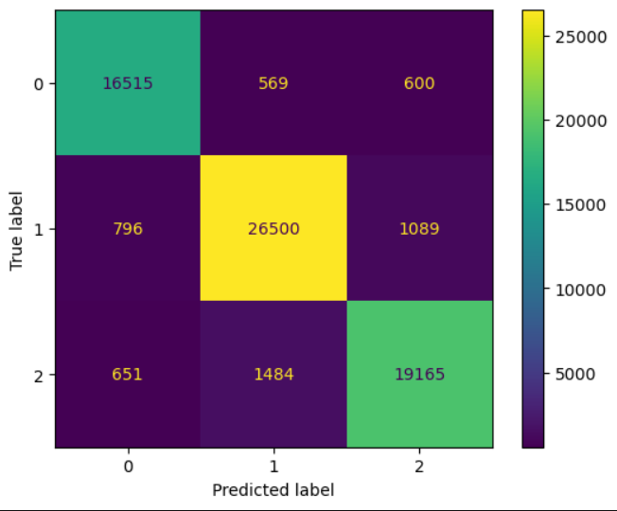
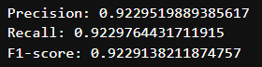
Logistic Regression Model
Multinomial Naïve Bayes Model

Slide 32
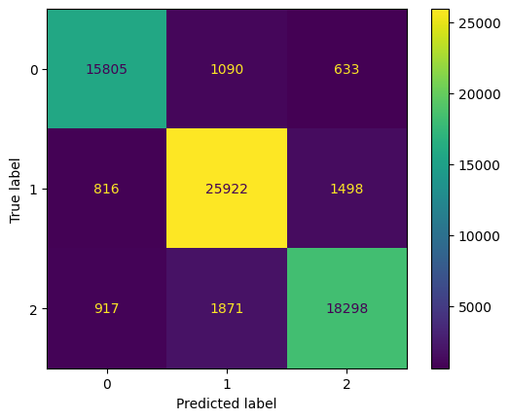
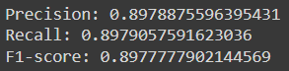
K-Nearest Neighbor
Logistic Regression Model

Slide 33
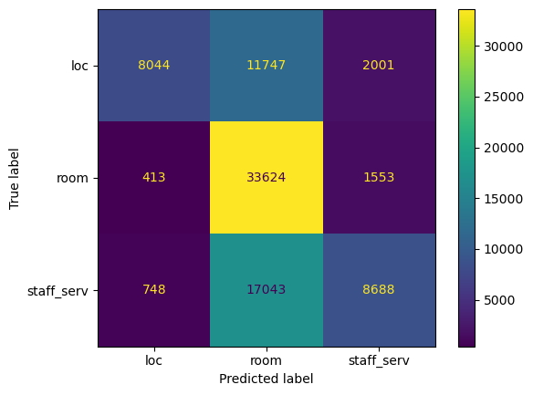
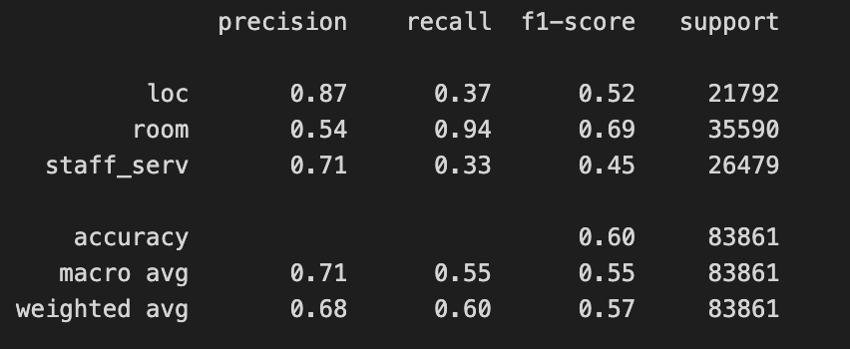
K-Nearest Neighbor
BERT Model (1 epoch)

Slide 34
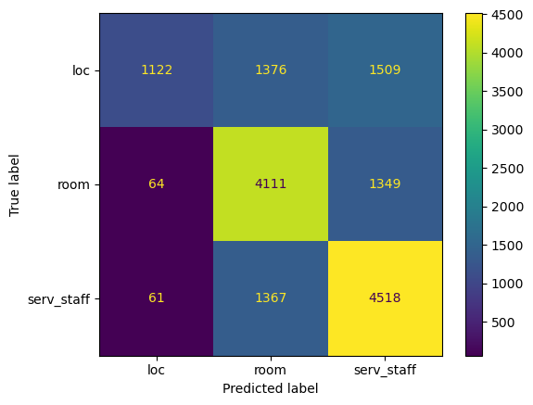
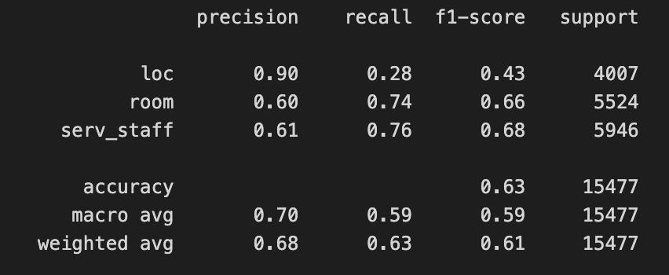
BERT Model (1 epoch)
BERT Model (3 epochs)

Slide 35
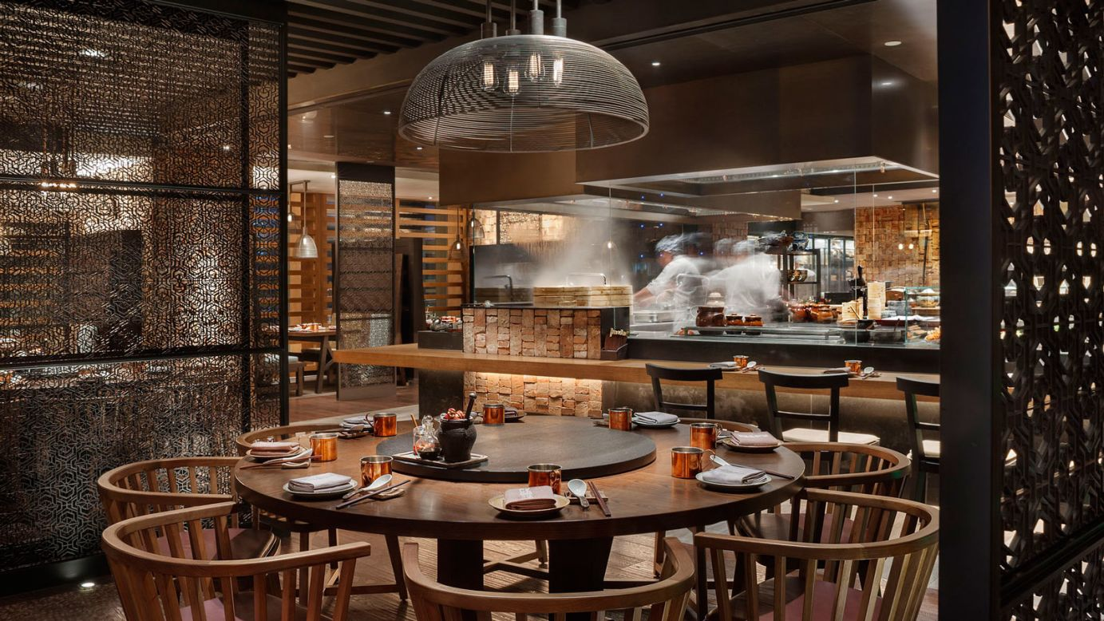
MODEL RESULTS AND EVALUATION

Slide 36
Splitting Reviews Into Phrases/Sentences
Refinement of Classification Process:
Utilization of the predict_proba function to obtain probabilities for each class prediction.
Identification of an optimal cutoff threshold score to distinguish relevant classifications.
Implementation of a criterion where data with a classification probability exceeding the threshold are considered location-related.
Significance of this approach in handling comment segments that may not pertain to the targeted topics.
Evaluation of Model Performance:
Assessment of model performance on previously unconsidered data, our test set.
Random sampling of 500 instances from the test set for manual verification.
Documentation of results in Excel and meticulous review of each row.

Slide 37
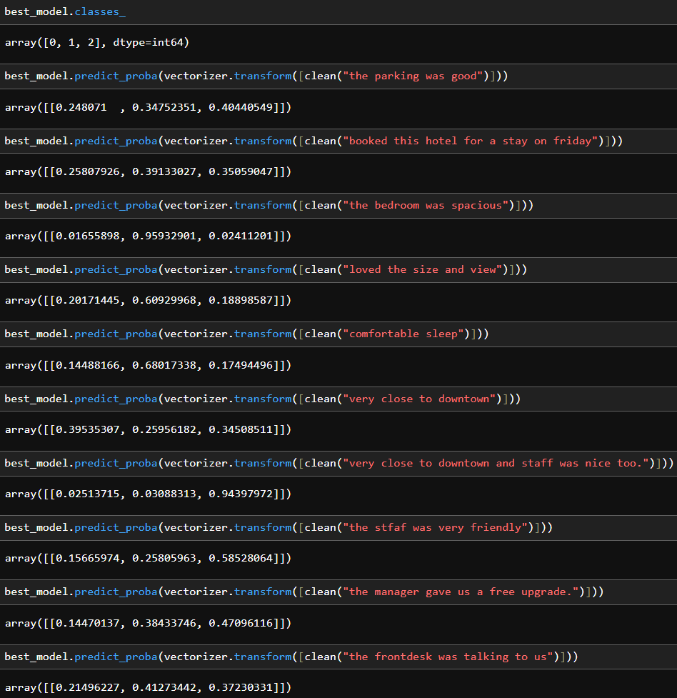
Outcome of Evaluation:
The results look satisfactory.
Segments exceeding a classification probability score of 0.62 achieved an accuracy rate of 94.3% in identifying relevant topics.

Slide 38
Do you have any questions?
THANK YOU

